Slide 1
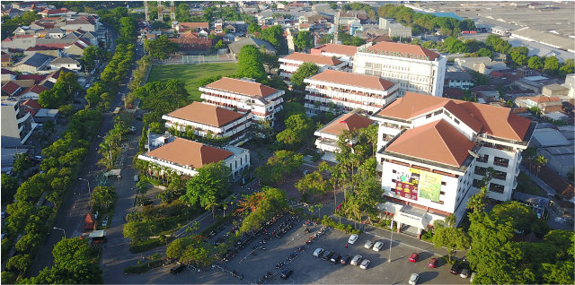

Internationationalisation Program at Ubaya
NMT WORKSHOP 2
(14-16 July 2022)

Slide 2

Contact
Adi Tedjakusuma
(Director Office of Institutional Cooperation)
atedjakusuma@staff.ubaya.ac.id

Slide 3
Ubaya Profile
Established in 1968, Ubaya is known as one of the leading private universities in Indonesia and the Asia and the Pacific
Received “A” Institutional Accreditation Score
The university now educates 12,000 students from 8 different faculties

Slide 4
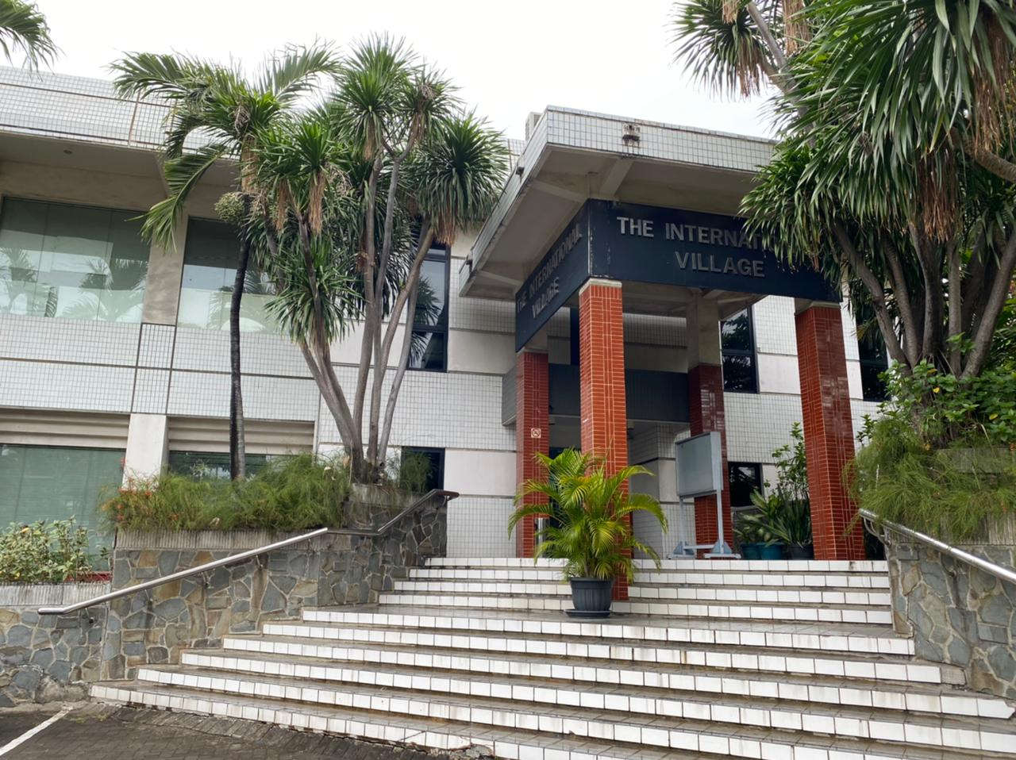
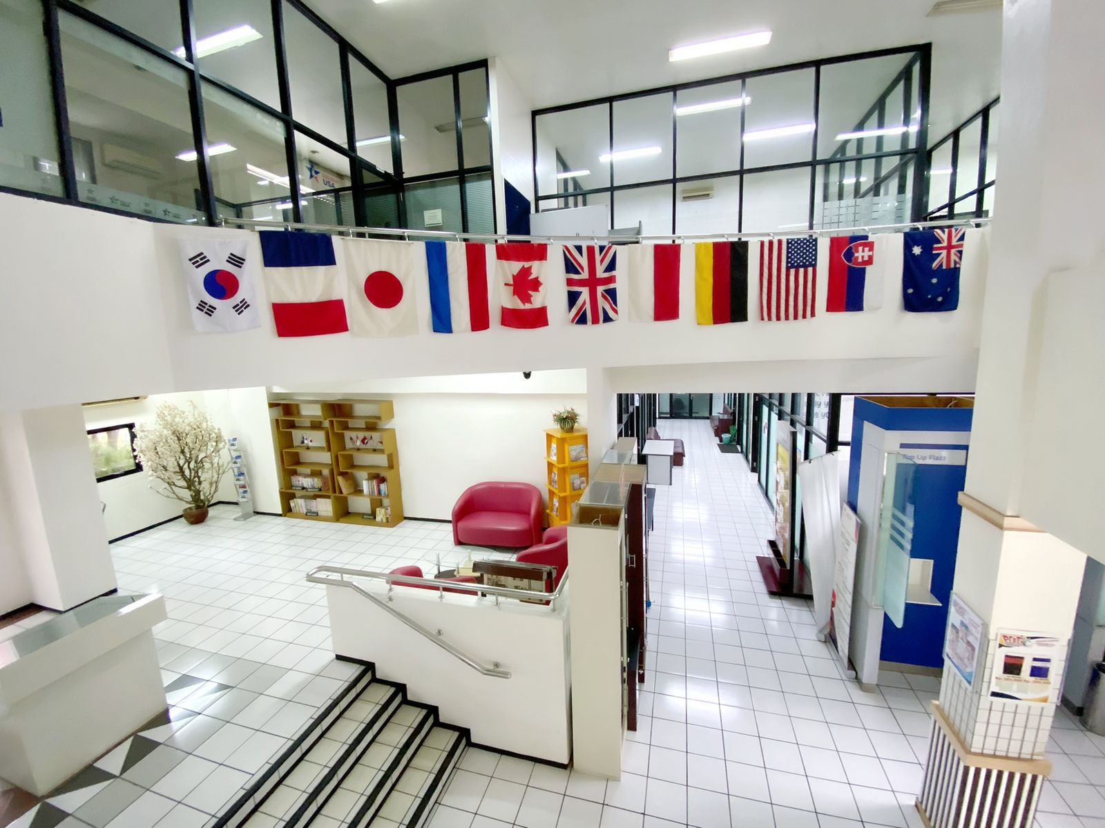
Internationalisation at Ubaya
Managed by Office of Institutional Cooperation (DKK)
Responsible to national and international partnerships

Slide 5
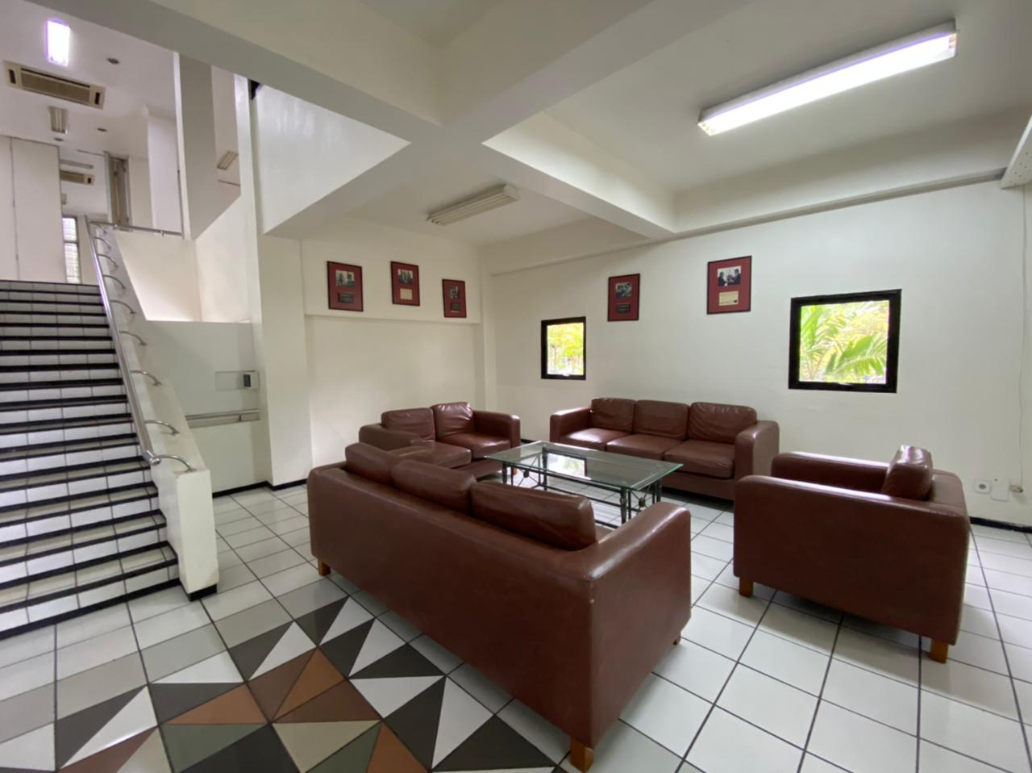
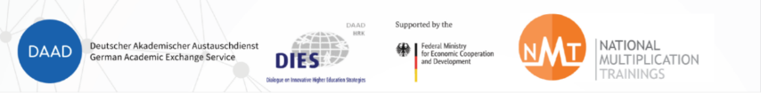
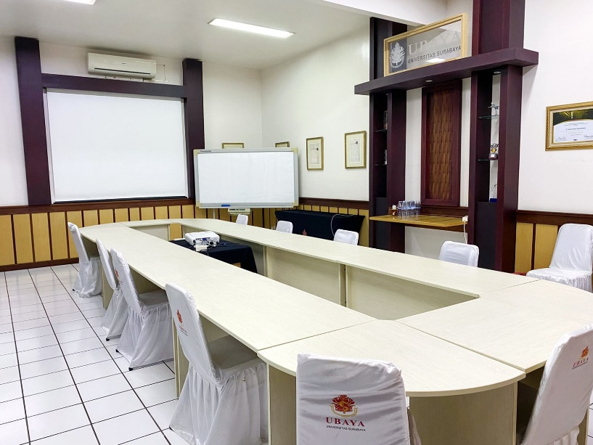

Slide 6
DKK Organizational Structure
Rector
Director
Manager for National Partnerships
Manager for International Partnerships
Adm
staffs
Adm
staffs
Adm
staffs
Adm
staffs

Slide 7
DKK Programs
Student Mobility
  Inbound:
    Student Exchange
    International Scholarship
    Summer Program
    Student Research
  Outbound
    Student Exchange Program
    Short Course Program
    Joint Degree
    IISMA
    ICT
    MBKM

Slide 8
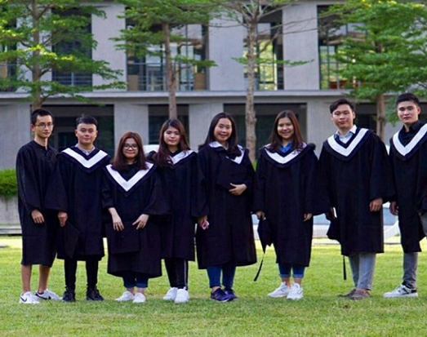
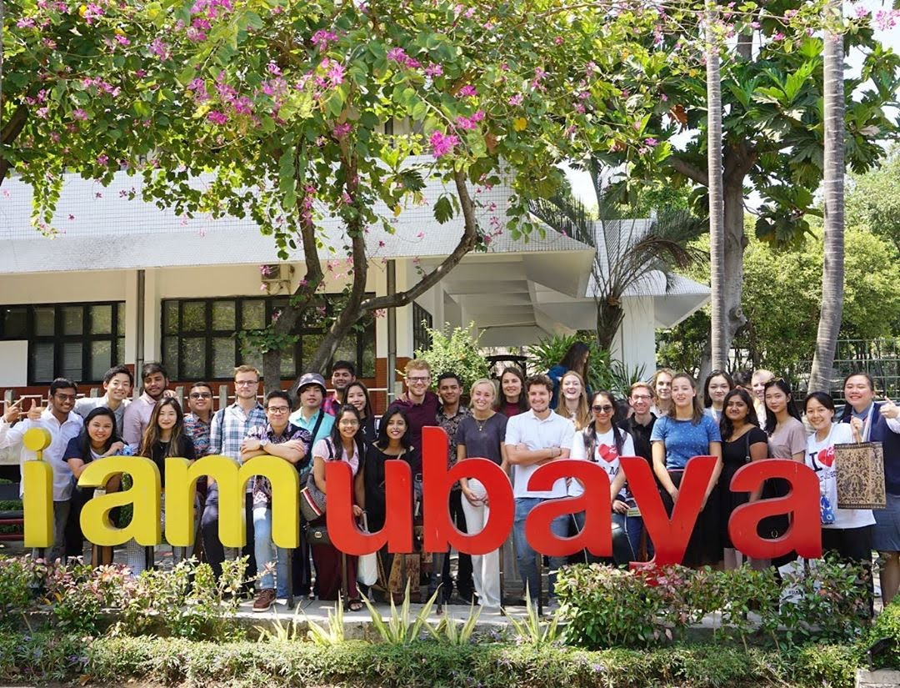


Slide 9
DKK Programs
International Partnerships Gate
Supports:
  International Accreditation Supports to Faculty
  QS Ranking Support to Quality Assurance Office

Slide 10





International Accreditation
Faculty of Business and Economics
Faculty of Pharmacy
Electrical, Chemical, Industrial Engineering, Informatics Engineering
Faculty of Pharmacy, Faculty of Engineering, Faculty of Psychology, Faculty of Biotechnology

Slide 11


International Recognition
Four Ubaya study programs: Pharmacy, Industrial Engineering, Psychology, and Biotechnology received International Recognition from AUN-QA in 2019

Slide 12
Thank you

